Slide 1

Career Services Overview
By :Casey Spurgeon, Career Director
cspurgeon@trilogyed.com 760.419.8209

Slide 2
ONE TEAM-ONE GOAL: EMPOWER JOB SEEKERS
AKA: Our students
Career Services
Student Facing
Non Student Facing
Curriculum
Coaching
Strategic Partnerships
Talent Solutions
Profile Coaches (PC)
Career Director (CD: Me)

Slide 3
Overview- Assignments/Schedule
Getting Started on Your Job Search
Due: 11/25
Feedback given by: 12/9 from Career Director
Building your Bio and Perfecting your Pitch
Due: 12/9
Feedback given by: 12/23 from Profile Coach
Behavioral Interview Session-NOT HOMEWORK (A REQUIREMENT)
Monday, December 11th from 5:30-7:00
Revising your Resume
Due: 2/03/2018
Feedback given by: 02/17/2018 from Profile Coach
Creating Your Online Presence
Due: 03/17/2018
Feedback given by: 03/31/2018 from Profile Coach
7 Career HW assignments in total!

Slide 4
Overview- Assignments/Schedule Cont.
Week 21 Coaching Calls Start
Week 25 Coaching Calls Start
Networking Practice
Due on 05/05/2018
Feedback given by: 05/19/2018 by Profile Coach
I will reach out week 19 to schedule
All dates are subject to change and all Career Homework can be done any date prior to due date!

Slide 5


Job Ready V.S Job Search Ready
V.S
What's the Difference and whose involved?

Slide 6
Job Ready V.S Job Search Ready Cont.
You
Job Ready
Job Search Ready
Career Director
TA’s
Profile Coach
SSM
What do you see??

Slide 7
Employer Ready V.S Employer Competitive
https://docs.google.com/document/d/1iAsuesIvhTigeGRswDGPbajY9WSodBMCh1HkM1oREhU/edit

Slide 8

Qualifying for Student Services: Student Expectations
Must meet requirements 4-5 weeks PT prior to graduation to qualify
ACADEMIC:
Attending a minimum of 95% of classes
Completing a minimum of 90% of your homework with a passing grade
Remaining current with your financial obligations
Maintaining legal status to work in the United States

Slide 9

Qualifying for Student Services: Student Expectations
Must meet requirements 4-5 weeks PT prior to graduation to qualify:
CAREER:
Approved Documentation/Profiles:
An approved resume meeting professional standard requirements
An approved LinkedIn Profile
A completed and approved portfolio of deployed projects and Github account
30-second Brand Statement
Attendance and participation in career services events
Commitment to updating tracking tool on your job search
Attend all scheduled career events
Be responsive and pro-active about your job search

Slide 10


Will you get me a Job??
What I am not….
VS. What I am….
SOURCER
REFERRAL MACHINE
COACH – empowers you with the right tools and strategies
No one can hand you a job.
We’re here to support, guide and coach you – while you embark on an aggressive job search.

Slide 11
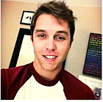
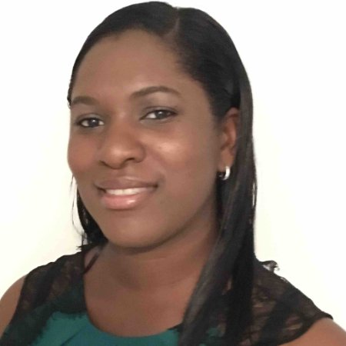
Who to Contact?/ Office Hours
CD – Casey Spurgeon
Works remotely 5 days/week, based out of San Diego ,CA.
Holding office hours every Wednesday from 4:00-5:00
Preferred method of contact: cspurgeon@trilogyed.com
If you’d like a 1:1 prior to Week 21 email/Slack me
PC – Camille Robinson-Harris
Works remotely, central team - based nationally.
Will give you feedback on your homework via google doc - address comments there.
Preferred method of contact:crobinsonharris@trilogyed.com

Slide 12
Resources:
National Career Events/Webinars
https://sites.google.com/trilogyed.com/careerevents/home
Career Resources:
https://docs.google.com/document/d/1C7ZDeCIhrncXZHKnOmDUt1bD34cls2lAY-XiROhtImg/edit
Technical Resources:
https://docs.google.com/document/d/1bIEY5-u_tVckOebEB3Bkdm-Qfoy_vIu6m09RcPZ3QLc/edit

Slide 13
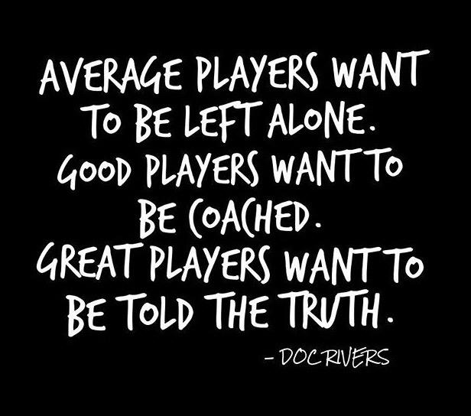
Words to remember…

Slide 14
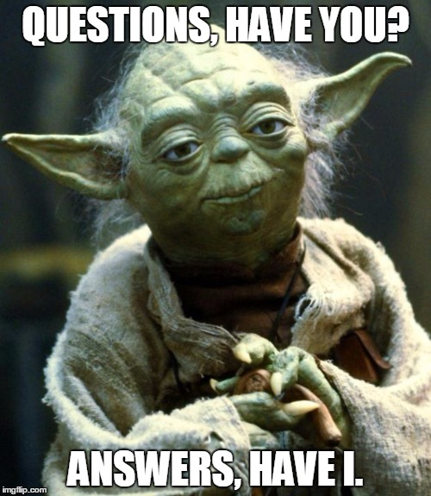
Q & A

